Slide 1


SHRI VISHNU ENGINEERING COLLEGE FOR WOMEN
(Autonomous)
DEPARTMENT OF COMPUTER SCIENCE & ENGINEERING
Title : Brain Tumour Detection using CNN
Batch - B05
Under the guidance of:​
Mrs.G.R.L.M.Tayaru​
Team members
1.K.Arthi(19B01A0574)​
2.K.Lovely Srenika(19B01A0583)​
3.M.Bhavana Swetha(19B01A0591)​
4.P.S.S.L.Srihitha(19B01A0599)​
5.N.L.S.Akhila(19B01A05C6)​

Slide 2
INTRODUCTION
Brain Tumour is a common problem that we see in our lives. A brain tumour is a mass or growth of abnormal cells in your brain.​
Tumour leads to the short life expectancy in their highest grade. Thus, treatment planning is a key stage to improve the quality of life of patients.​
So to know whether the tumour is present in the brain or not we use​Brain Tumour Detection Model.​
This Brain tumour detection model is developed ​by CNN.​

Slide 3

TECHNICAL SKILLS FOR SYSTEM DEVELOPMENT
Domain: DeepLearning
Python
CNN algorithm
OpenCV
TensorFlow

Slide 4
FUNCTIONALITIES
Preprocessing the input images
Splitting data to train and then test
Building model using CNN layers pooling, flattening,fully connection
Tumour detection present or not

Slide 5
DESIGN COMPARISON
Existing System
•In,1 the Fuzzy C-Means (FCM) segmentation is applied to separate the tumour and non-tumour region of brain. An accuracy rate of 96.97% in the analysis of DNN based brain tumour classification.
•The Fuzzy Interference System (FIS) is a one special technique, which is mainly used for brain segmentation. Supervised classification is used to create a membership function of fuzzy controller. The performance is high and accuracy is low.
•Finally, the fuzzy with K Nearest Neighbor (KNN) classification is applied to find the abnormality of brain MRI image. The complexity is high. But the accuracy is low.

Slide 6
DESIGN COMPARISON
Proposed System
Our project is to develop a “ Brain Tumour Detection Model” which detects the brain tumour from the given MRI images using CNN. And is a binary classification model.
This project is to increase the accuracy, decrease the complexity.
This is implemented in Python.
CNN is one of the deep learning methods, which contains sequence of feed forward layers.
The detection results are given as whether tumour is present or not in given MRI image of brain

Slide 7
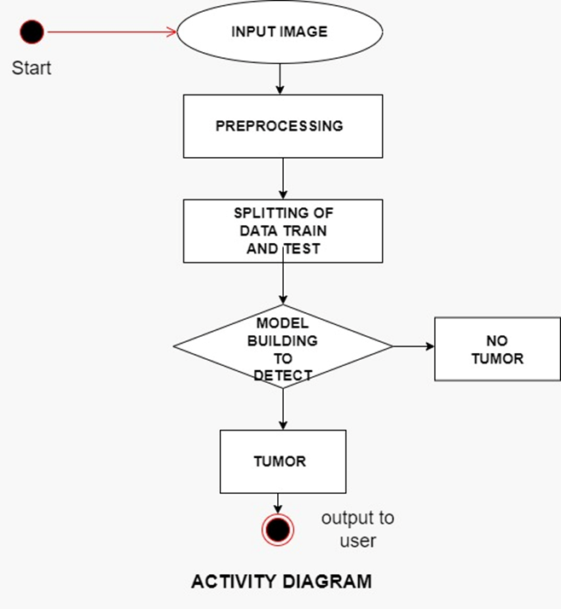
SYSTEM FLOW

Slide 8
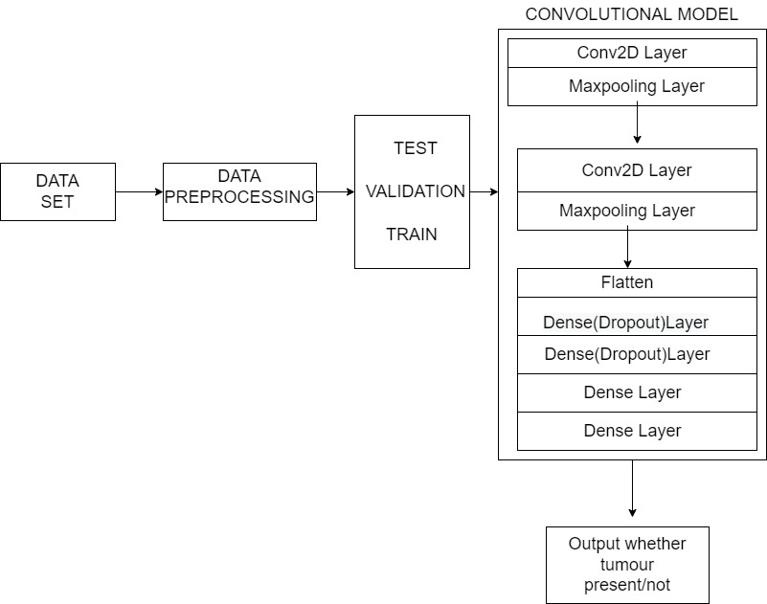

Slide 9
DATA DISTRIBUTION
Data
253 Images
Training
202 Images
Testing
51 Images

Slide 10
STEPS INVOLVED FOR BUILDING MODEL
Step 1 – Import Required libraries
Step 2 – Initializing CNN
Step 3 – Pooling operation
Step 4 – Add convolutional layers
Step 5 – Flattening operation
Step 6 – Fully connected layer & output layer

Slide 11
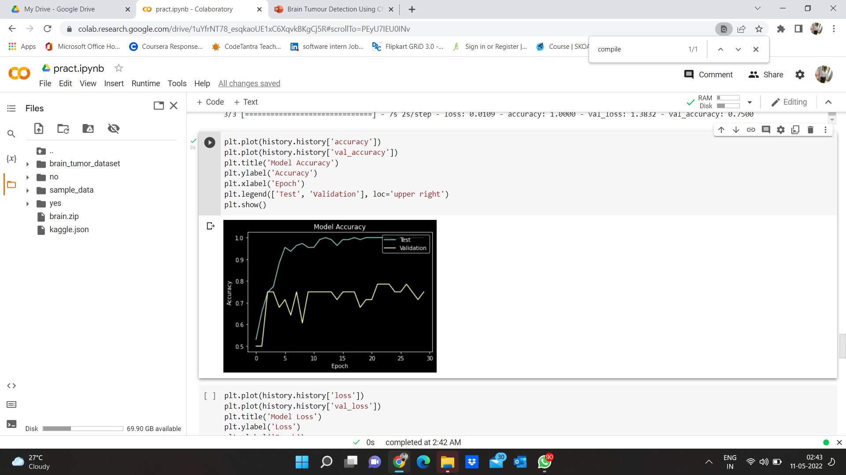
ACCURACY PLOT OF THE MODEL

Slide 12
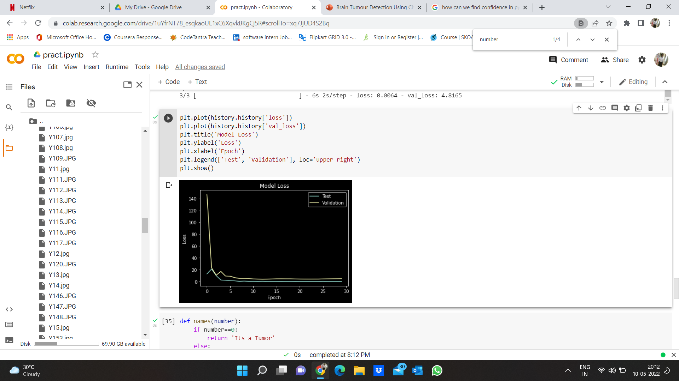
LOSS PLOT OF THE MODEL

Slide 13
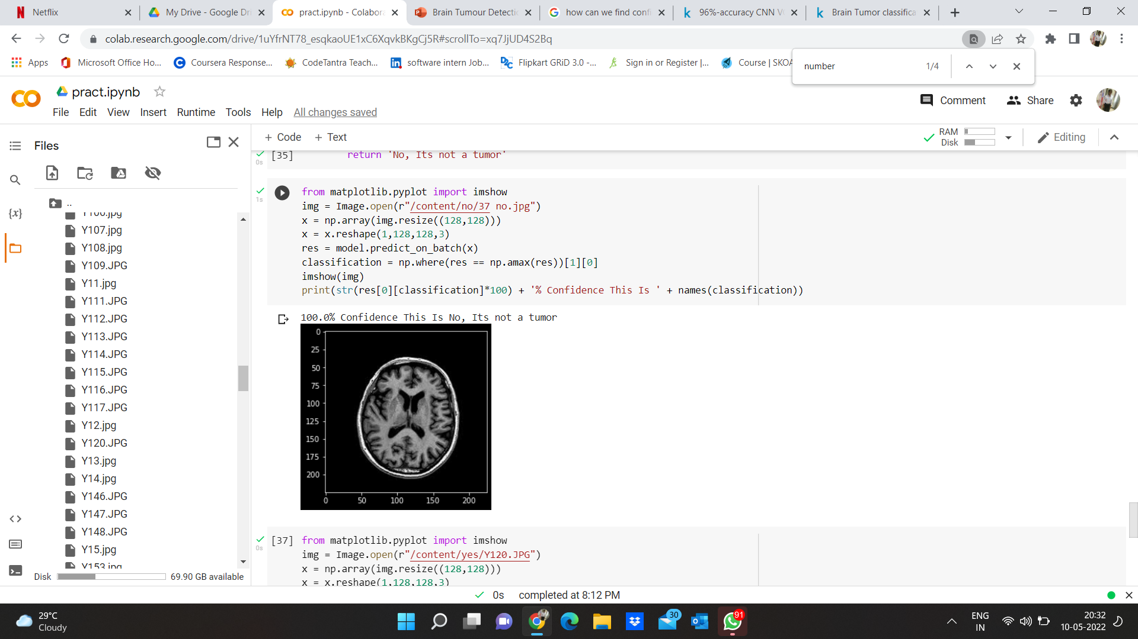
OUTPUT OF TESTING

Slide 14
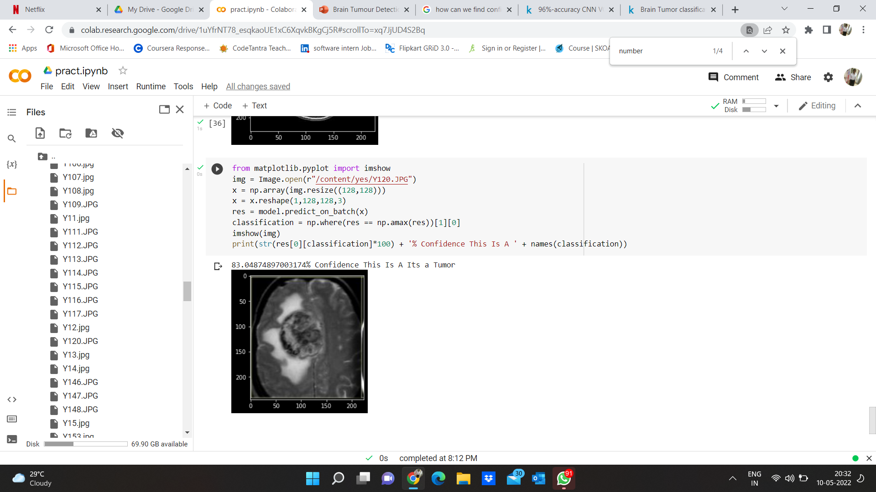
OUTPUT OF TESTING

Slide 15
FUTURE SCOPE
It is observed on extermination that the proposed approach needs a vast trainingset for better accurate results; in the field of medical image processing, the gathering ofmedical data is a tedious job, and, in few cases, the datasets might not be available.
In all such cases, the proposed algorithm must be robust enough for accurate recognitionof tumor regions from MR Images.
The proposed approach can be further improvised through in cooperating weakly trained algorithms that can identify the abnormalities with a minimum training data and also self-learning algorithms would aid in enhancing the accuracy of the algorithm and reduce the computational time.

Slide 16
CONCLUSION
The Project “Brain Tumour Detection Using CNN” successfully implemented all features and tested will all the possible test cases and achieved satisfying results. The main aim of this project is to be able improves the accuracy with minimal computational time and less complexity and achieve the validation accuracy will be high and validation loss will be very low, time taken for detecting the brain tumor is relatively less in comparison with the algorithms proposed earlier. The aim of this project is attained through CNN Model.

Slide 17


